Slide 1
Project Starfighter 1.0
Team 16 – 1 = 15

Slide 2
User Stories for 1.0 Part 1
As a user who clicks on the menu option, 'start the game,' I want to be presented with the game's background as well as my remaining lives, my current score, the level that I am in, and my user player.
As a user starting the game, I want to be presented with a menu with the following options: start the game, instructions to play the game, scores, and an option to quit the game.

Slide 3
User Stories for 1.0 Part 2
As a user who clicks on the menu option, 'scores,' I want to be presented with a list of the highest scores.
As a user who clicks on the menu option, 'Quit,' I want to close the game.
As a user who clicks on the menu option, 'instructions,' I want to be presented with the instructions to play the game.
As a user who clicks on the mnu option, ‘credits,’ I want to be presented with the credits for the game

Slide 4
User Stories for 1.0 Part 3
As a user who in the menu option, 'high scores,' I want to able to return to the main menu.
As a user who in the menu option, ‘instructions,' I want to able to return to the main menu.
As a user who in the menu option, ‘credits,' I want to able to return to the main menu.

Slide 5
Credit Screen Test Code

Slide 6
Game Screen Test code

Slide 7
High Score Screen Test Code

Slide 8
Instructions Screen Test code

Slide 9
Menu Component Test Code

Slide 10
PopUp Screen Test Code

Slide 11
Starfighter Test Code

Slide 12
Start Screen Test Code

Slide 13
Action Screen Test Code

Slide 14
AnimatedSprite Test Code
using System;
using System.Text;
using System.Collections.Generic;
using System.Linq;
using Microsoft.VisualStudio.TestTools.UnitTesting;
using Project_Starfighter;
using Microsoft.Xna.Framework;
using Rhino.Mocks;
namespace Project_Starfighter_Test
{

Slide 15
AnimatedSprite Test Code
[TestClass]
public class AnimatedSprite_Test
{
AnimatedSprite animatedSprite;
GameTime gameTime;
public AnimatedSprite_Test()
{
animatedSprite = new AnimatedSprite();
gameTime = MockRepository.GenerateStub<GameTime>();
}

Slide 16
AnimatedSprite Test Code
[TestMethod]
public void XPosition_Test()
{
animatedSprite.X = 11;
Assert.IsTrue(11 == animatedSprite.X);
}
[TestMethod]
public void YPosition_Test()
{
animatedSprite.Y = 12;
Assert.IsTrue(12 == animatedSprite.Y);
}

Slide 17
AnimatedSprite Test Code
[TestMethod]
public void Frame_Test()
{
animatedSprite.Frame = 3;
Assert.IsTrue(3 == animatedSprite.Frame);
}
[TestMethod]
public void FrameLength_Test()
{
animatedSprite.FrameLength = 2;
Assert.IsTrue(2 == animatedSprite.FrameLength);
}

Slide 18
AnimatedSprite Test Code
[TestMethod]
public void IsAnimating_Test()
{
animatedSprite.IsAnimating = false;
Assert.IsTrue(false == animatedSprite.IsAnimating);
}
[TestMethod]
public void GetSourceRectangle_Test()
{
Rectangle r = new Rectangle(2, 2, 2, 2);
Rectangle r2 = animatedSprite.GetSourceRect();
Assert.AreEqual(r, r2);
}

Slide 19
AnimatedSprite Test Code
[TestMethod]
public void Update_Test()
{
animatedSprite.IsAnimating = true;
animatedSprite.Elapsed = 1;
animatedSprite.Frame = 2;
animatedSprite.Update(gameTime);
Assert.IsTrue(3 == animatedSprite.Frame);
}
}

Slide 20
Background Test Code
using System;
using System.Text;
using System.Collections.Generic;
using System.Linq;
using Microsoft.VisualStudio.TestTools.UnitTesting;
using Project_Starfighter;
namespace Project_Starfighter_Test
{

Slide 21
Background Test Code
[TestClass]
public class Background_Test
{
Background background;
public Background_Test()
{
background = new Background();
}

Slide 22
Background Test Code
[TestMethod]
public void BackgroundOffset_Test()
{
background.BackgroundOffset = 1;
Assert.IsTrue(1 == background.BackgroundOffset);
}
[TestMethod]
public void BackgroundWidth_Test()
{
background.BackgroundWidth = 2;
Assert.IsTrue(2 == background.BackgroundWidth);
}

Slide 23
Background Test Code
[TestMethod]
public void BackgroundHeight_Test()
{
background.BackgroundHeight = 2;
Assert.IsTrue(2 == background.BackgroundHeight);
}
[TestMethod]
public void BackgroundFileWidth_Test()
{
background.BackgroundFileWidth = 3;
Assert.IsTrue(3 == background.BackgroundFileWidth);
}

Slide 24
Background Test Code
[TestMethod]
public void BackgroundFileHeight_Test()
{
background.BackgroundFileHeight = 4;
Assert.IsTrue(4 == background.BackgroundFileHeight);
}
}

Slide 25
Player Test Code
using System;
using System.Text;
using System.Collections.Generic;
using System.Linq;
using Microsoft.VisualStudio.TestTools.UnitTesting;
using Project_Starfighter;
using Microsoft.Xna.Framework;
using Rhino.Mocks;
namespace Project_Starfighter_Test
{

Slide 26
Player Test Code
[TestClass]
public class Player_Test : Microsoft.Xna.Framework.Game
{
Player testplay;
GameTime gameTime;
//SpriteBatch sp;
public Player_Test()
{
Background background = new Background();
gameTime = MockRepository.GenerateStub<GameTime>();
testplay = new Player();
//sb = MockRepository.GenerateStub<SpriteBatch>();
}

Slide 27
Player Test Code
[TestMethod]
public void XPosition_Test()
{
testplay.X = 11;
Assert.IsTrue(11 == testplay.X);
}
[TestMethod]
public void YPosition_Test()
{
testplay.Y = 12;
Assert.IsTrue(12 == testplay.Y);
}

Slide 28
Player Test Code
[TestMethod]
public void Facing_Test()
{
testplay.Facing = 1;
Assert.IsTrue(1 == testplay.Facing);
}
[TestMethod]
public void Thrusting_Test()
{
testplay.Thrusting = true;
Assert.IsTrue(true == testplay.Thrusting);
}

Slide 29
Player Test Code
[TestMethod]
public void ScrollRate_Test()
{
testplay.ScrollRate = 2;
Assert.IsTrue(2 == testplay.ScrollRate);
}
[TestMethod]
public void AccelRate_Test()
{
testplay.AccelerationRate = 3;
Assert.IsTrue(3 == testplay.AccelerationRate);
}

Slide 30
Player Test Code
[TestMethod]
public void BoundingBox_Test()
{
Rectangle r = new Rectangle(11, 12, 72, 16);
testplay.X = 11;
testplay.Y = 12;
Assert.AreEqual(r, testplay.BoundingBox);
}
[TestMethod]
public void Update_Test()
{
testplay.Facing = 2;
testplay.Thrusting = true;
testplay.Update(gameTime);
Assert.IsTrue(3 == testplay.asSprite.Frame);
}

Slide 31
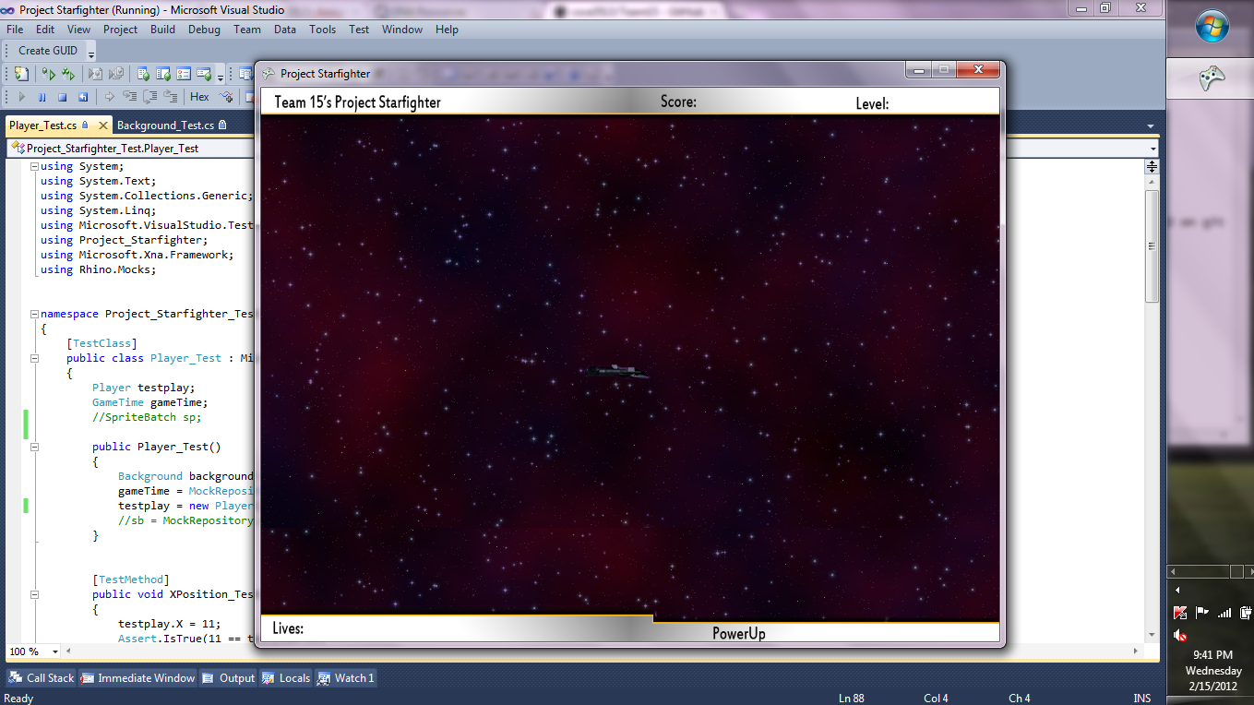
Background and Player demo

Slide 32
Status of the Game
At this point in time there is a menu interface that will work regardless of any changes made to gameplay.
The instructions, and high score screens are currently blank.
The game loads the first level but lacks the ability for the ship’s basic functions.

Slide 33
Plans for version 1.1
Give the ship the ability to move up, down, right and left via the direction keys or (WASD).
Give the ship the ability to shoot a laser.
Have the background automatically move at a set pace
Implement music in the main menus
Implement the use of either a text file, or a graphic window that can scroll, to display the instructions.

Slide 34


